Slide 1
UNIT 7:
INTERFACES, ENVIRONMENTS, ASSET MANAGEMENT, AND ANIMATION

Slide 2
UNIT DESCRIPTION
Activities in this unit of study are designed to engage the learner, providing rich skill building opportunities in areas of game interface creation for Human Computer Interfaces and Graphical User Interfaces.

Slide 3


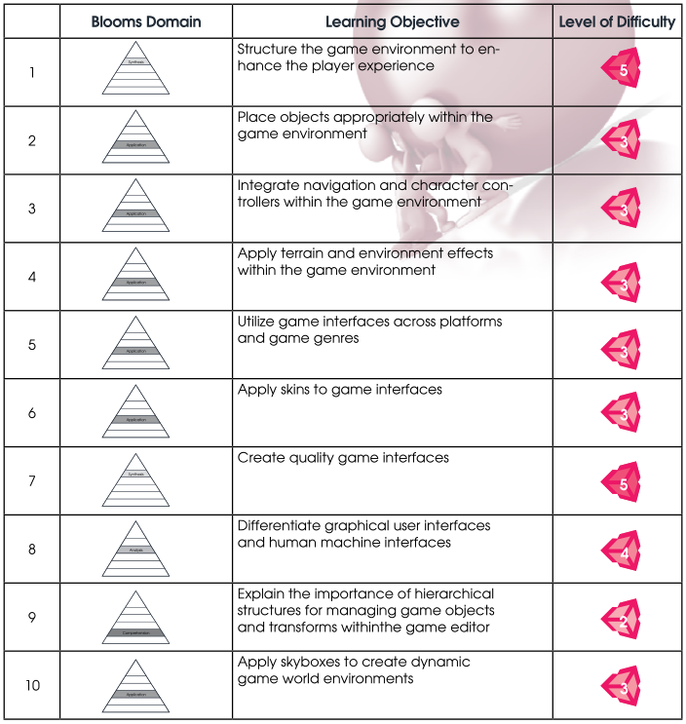
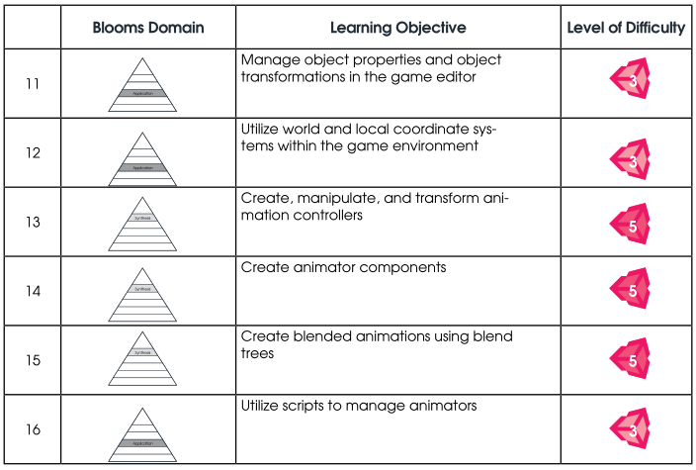



LEARNING OBJECTIVES
By the end of this unit, learners should be able to perform the following tasks:

Slide 4
COURSE OUTLINE

Slide 5
1. Developing the Game Environment
a. Components of the Game Environment
b. Creating Terrain for Realism
c. Trees, Grass and Water
d. Environment Effects: Skyboxes, Fog, Lens Flares
e. Character Controllers
f. Fixing Your Virtual World

Slide 6
2. Graphical and Human Machine Interfaces
a. Basics of GUI and HMI Design
b. GUI and HMI Controls
c. Labels, Buttons, Toolbars, Toggles, and Other Controls
d. Styles and Skins
A good UI tells you what you need to know, and then gets out of the way.
https://youtu.be/1-qpJUAwPc8
Notes:
-Predict what the user wants to know, and give them that information.
-Information must be easy to find.
-Your UI should be easy to use and navigate. Use established patterns where you can: Everyone knows that Ctrl-Click adds items to the selection, so don't make it swap items instead.
-Make the user's location in the menu system obvious, and make it obvious where the user can go and what they can do from there.
-Minimise load times and avoid animations in your menus.
-Eliminate or simplify repetitive tasks.

Slide 7
3. Creating Animations in Unity
a. Advanced Animations
b. Preparing Models for Animation

Slide 8
Animation within an Interface
As learners design their game interfaces and interactions, it is valuable for them to develop animations that run the game action and richen the game environment. The following tutorials will help learners develop technical animation skills in Unity.
1. Animator Component and Game Objects:
http://unity3d.com/learn/tutorials/modules/beginner/animation/animator-component
2. Animator Controllers:
http://unity3d.com/learn/tutorials/modules/beginner/animation/animator-controller
3. Avatar Masks:
http://unity3d.com/learn/tutorials/modules/beginner/animation/avatar-masks
4. Animator Scripting:
http://unity3d.com/learn/tutorials/modules/beginner/animation/animator-scripting
5. The Animation View:
http://unity3d.com/learn/tutorials/modules/beginner/animation/animation-view
6. Animation Properties:
http://unity3d.com/learn/tutorials/modules/beginner/animation/animation-properties

Slide 9
Capstone Project
Learners should be actively building their Capstone Project in Unity. At this time, learners can animate objects in the game they are creating. By this point, some learners may have already been trying to animate objects in their game. If that is the case, some learners may require additional time to adapt, refine, or update their previous work. At this point, game development should be progressing and some game elements should become playable within the game environment. Do not be alarmed if there are varying degrees of progress! This is common and may be caused by several factors, including complexity of their game choice and the individual ability of the learner. In some cases, learners may want to return to work already completed, refining or replacing specific sections or entire areas of their game.

Slide 10
Game Design Document (GDD)
Draft sections 2.3.4 – User Interface, 2.3.5 - Heads Up Display of 3.2 - Visual Content in your Game Design Document (GDD).

Slide 11
Weekly Assignment
in this activity, you will open several games of your choosing from this link:
http://unity3d.com/showcase/gallery
Think about what you like and do not like about each user interface. Create several sketches of the user interface for the game you are designing. Think about what controls will be needed and how you want them to appear, as well as a design for buttons and any other design components that you want to include. When you are finished with this assignment, you will have a final design for the game you are building. You will then be ready to create your own custom game interface.

